Slide 1

Gain and Phase Analyzer
May 8, 2015
Notes:
Kaidi

Slide 2

Team
Chris Pavlina
Electrical Engineer, Team Lead
Harrison Owens
Computer Engineer
Ken Zach
Computer Engineer
Kyle Temkin
Faculty Advisor
Notes:
Kaidi

Slide 3
Agenda
Purpose
Requirements
Design
Schedule
Budget
Next Steps
Notes:
Kaidi

Slide 4
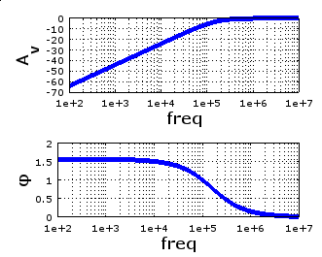
Purpose
Test the performance of filters, amplifiers
Generate Bode plot with
amplitude and phase
Notes:
Kaidi

Slide 5

Uses
Education
Testing, design, characterization of:
Signal filters
Signal amplifiers
Control systems
Notes:
Chris

Slide 6
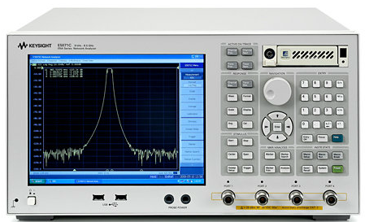
Why?
Current state of industry
Large
Expensive
Learning curve
Students can’t see how it works!
Our Goal
Portable
Cost around $200
Easy to use for students and teachers
Open source
Image: Keysight Technologies, “E5071C ENA Series Network Analyzer”
Notes:
Chris

Slide 7
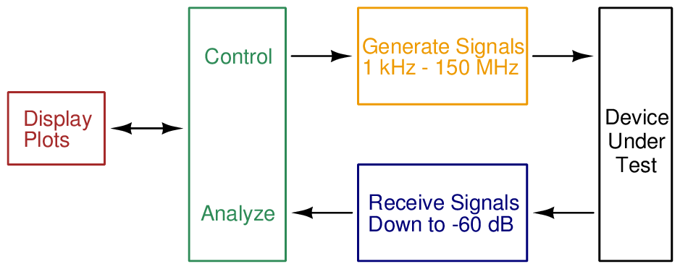
Requirements
Notes:
Chris

Slide 8
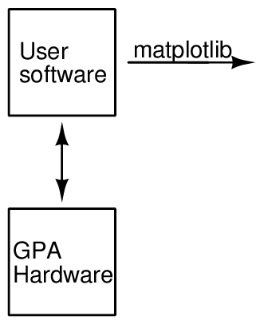
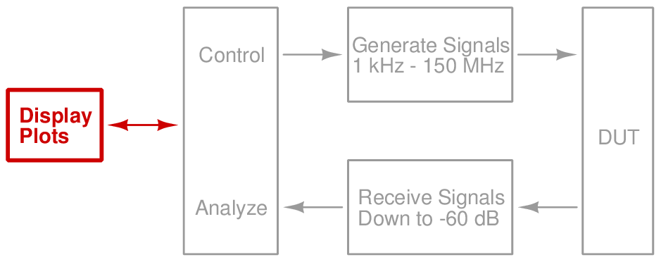
Design — Software
Notes:
Harrison

Slide 9
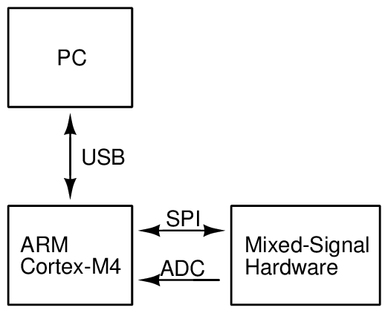
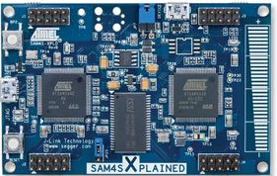
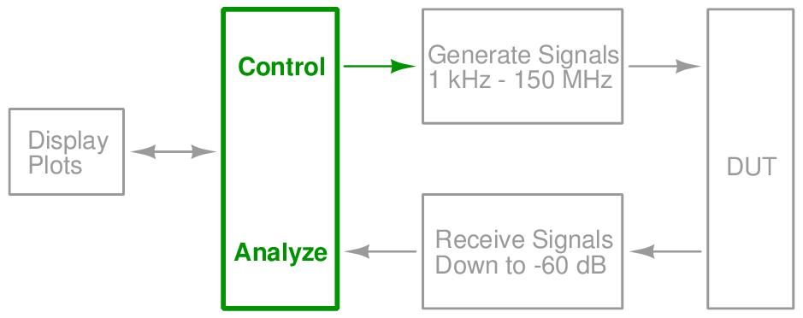
Design — Microcontroller
Notes:
Harrison

Slide 10
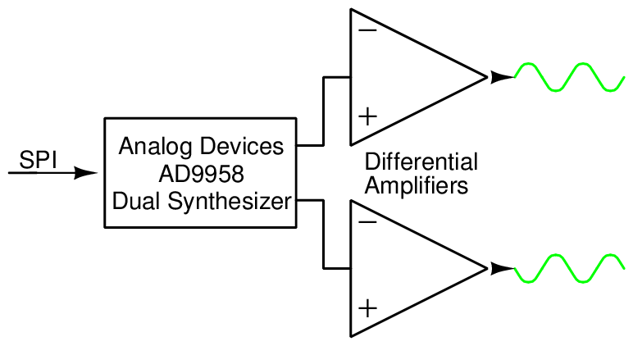
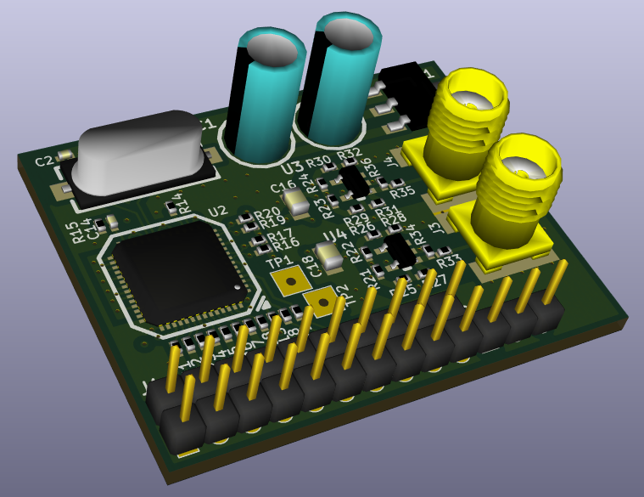
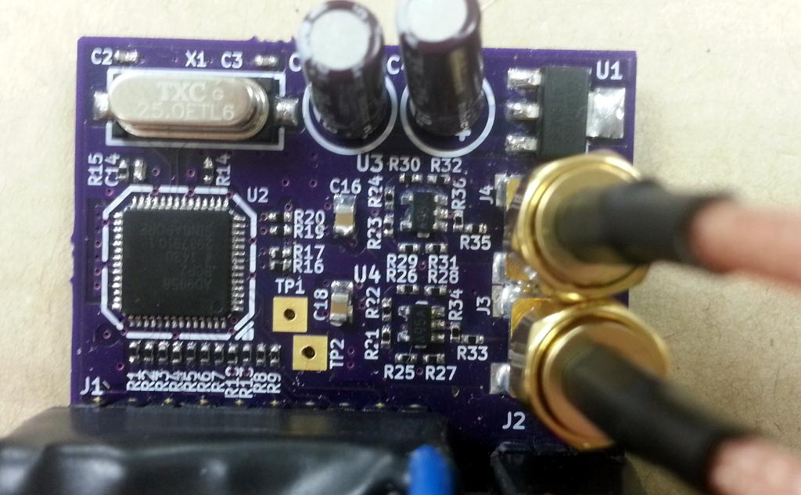
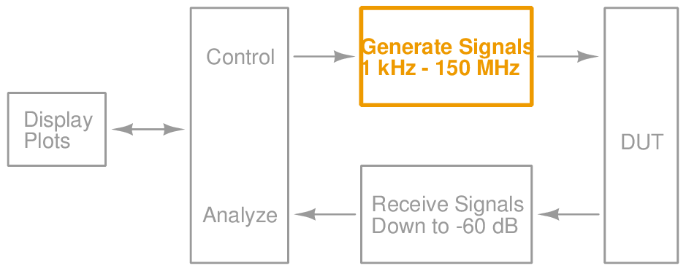
Design — Signal Generation
Notes:
Ken

Slide 11
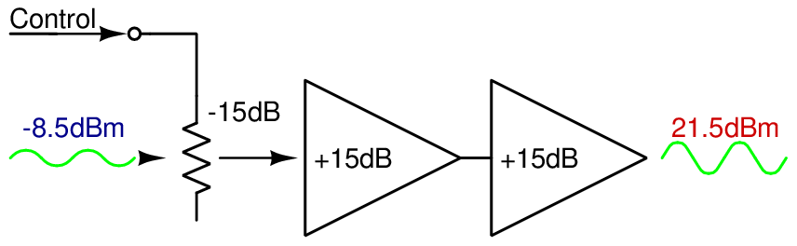
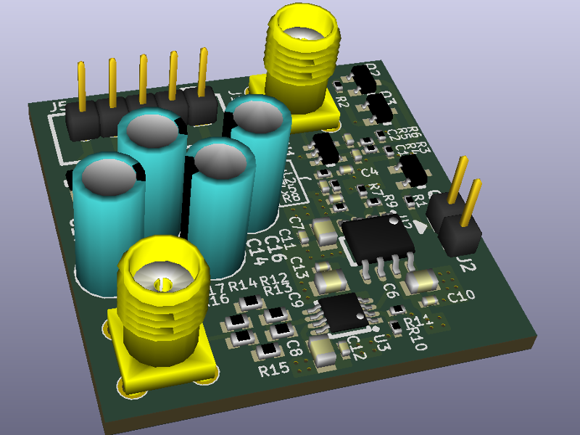
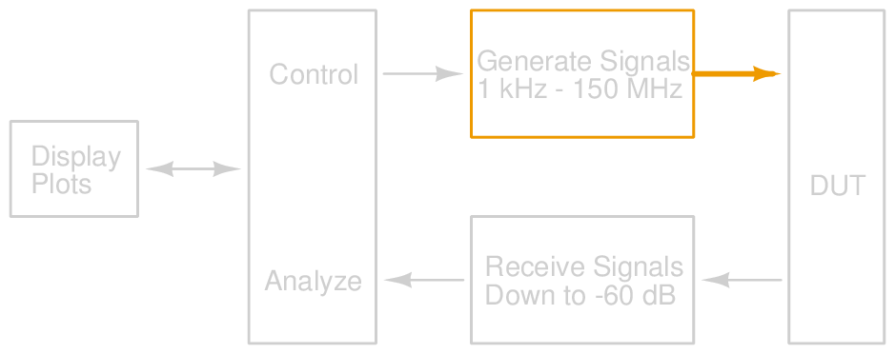
Design — Signal Output
Notes:
Ken

Slide 12
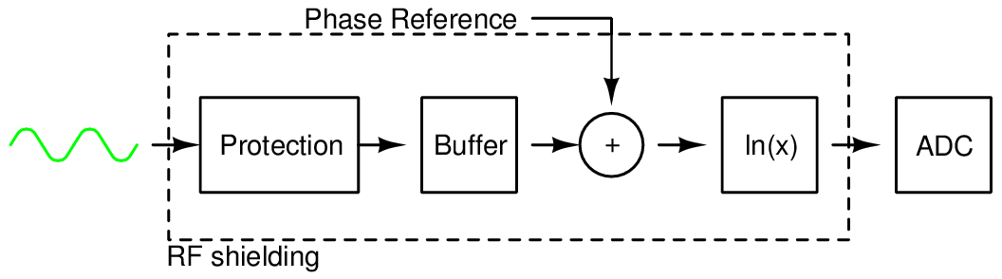
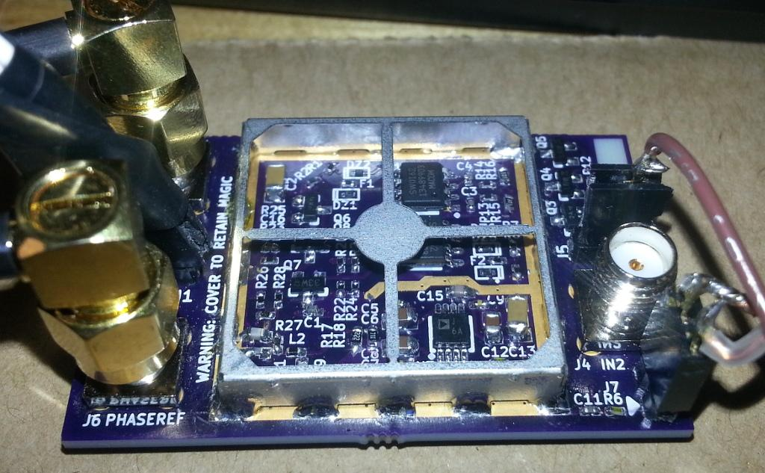
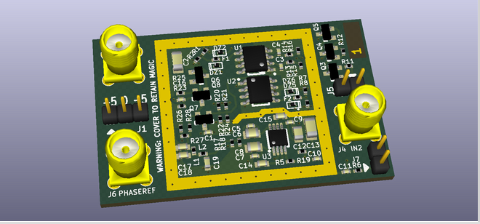
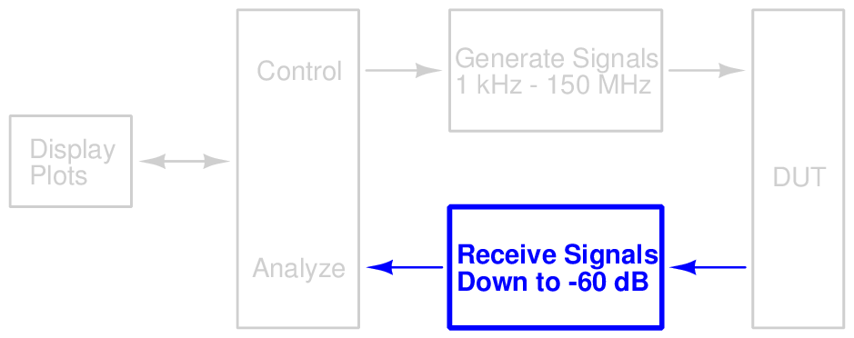
Design — Detection
Notes:
Chris

Slide 13
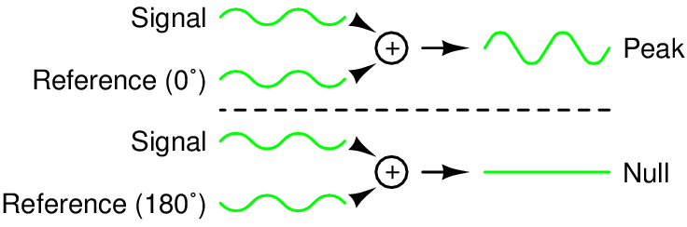
Design — Phase Detection
Notes:
Chris

Slide 14
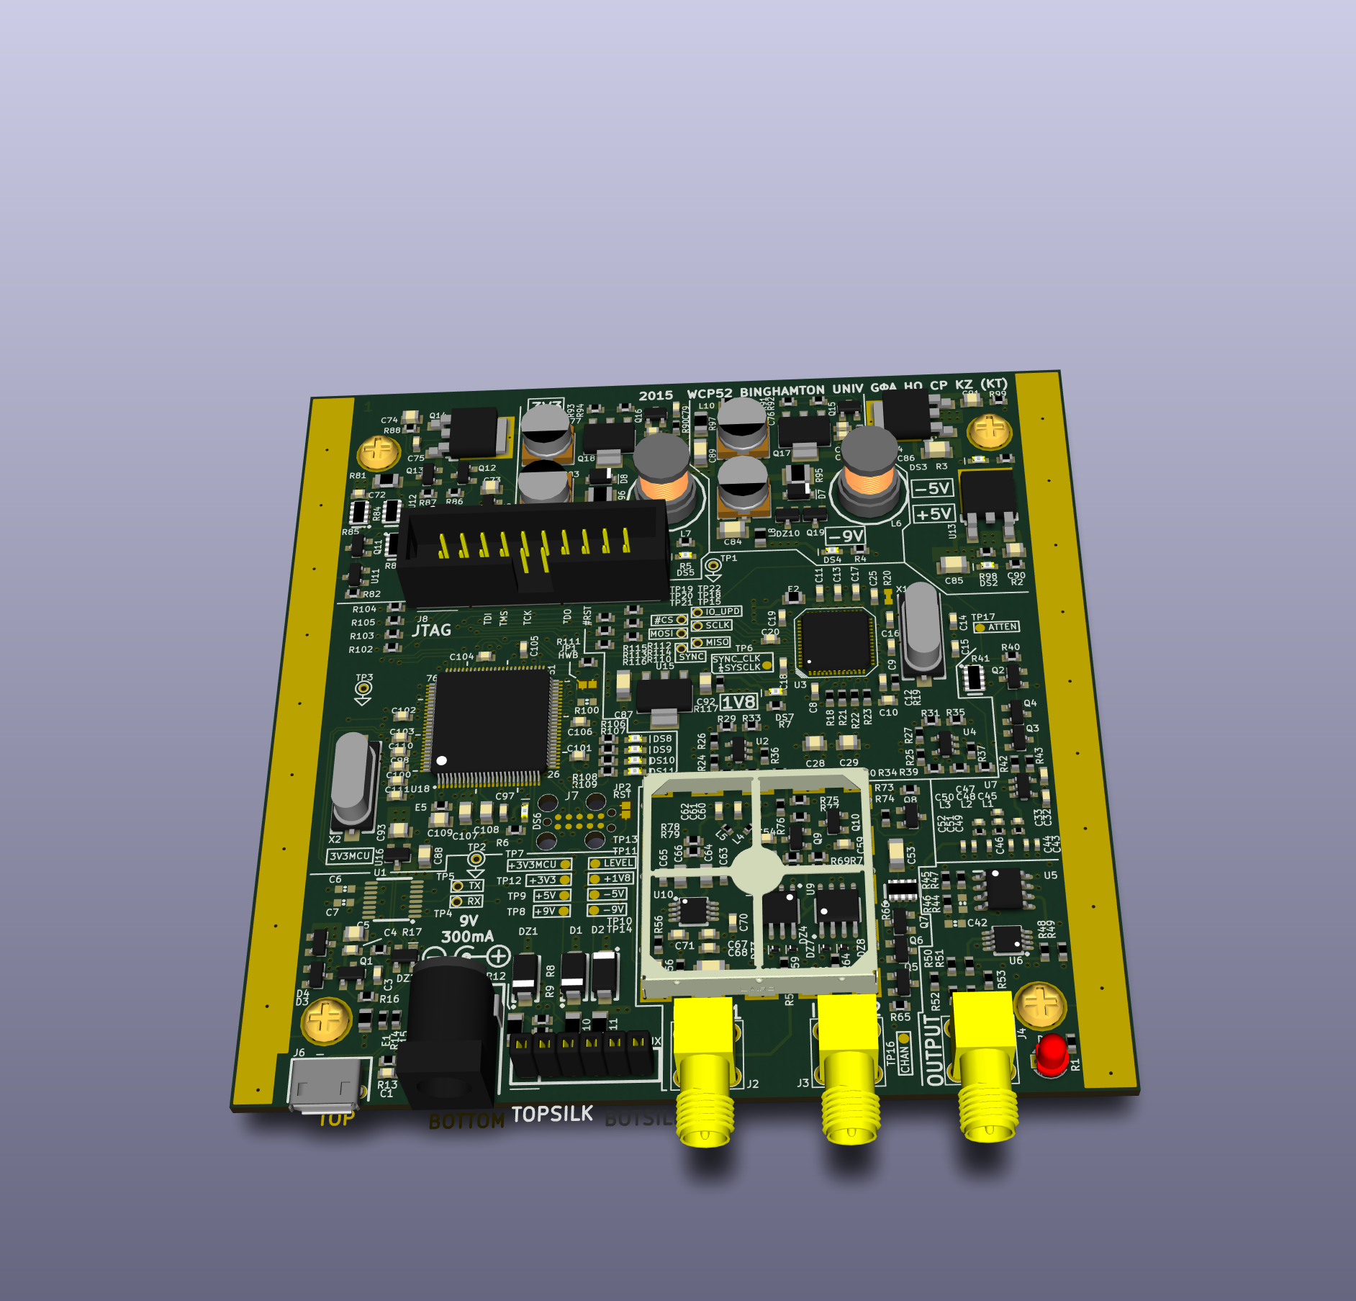
Design — PCB
Notes:
Harrison

Slide 15
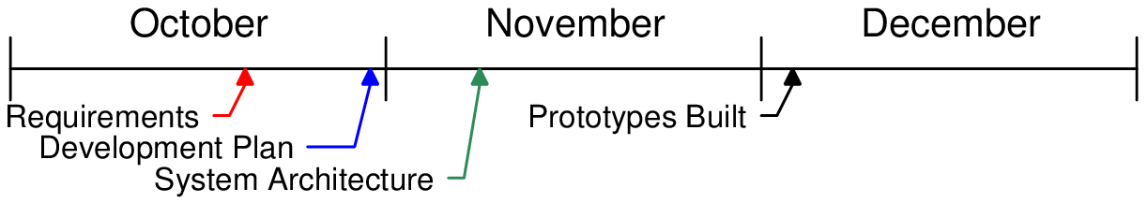
Timeline
Notes:
Harrison

Slide 16
Schedule
Item | Completed
Specification | October 17, 2014
Development plan | October 31, 2014
Prototypes built | December 5, 2014
Interim | December 5, 2014
Prototypes corrected | February 26, 2015
Final PCB layout | March 14, 2015
Alpha firmware completed | March 19, 2015
PCB assembled | April 8, 2015
PC software completed | April 30, 2015
Notes:
Harrison

Slide 17
Budget
Item | Expended | Actual | Estimated to Completion | Estimated at Completion
Synth. proto. | $60 | $60 | $0 | $60
Input proto. | $70 | $70 | $0 | $70
Amp proto. | $91 | $91 | $0 | $91
Final build | $210 | $210 | $0 | $210
Enclosure | $21 | $21 | $0 | $21
Total | $452 | $452 | $0 | $452
Notes:
Harrison

Slide 18
Next Steps
Hardware
Combine prototypes into a final product
Software
Finish firmware with full analysis capability
Write PC software that receives and plots data
Calibration
Finalization
Operating manual
Software packaging and installation
Notes:
Ken

Slide 19
Conclusion
Product can capture Bode plots
Uses signal synthesizer, output amplifier, input frontend, ADC, and microcontroller
These have been prototyped and tested
Notes:
Kaidi

Slide 20
Demo

